Slide 1

Graph Theory and its Applications
Arti Arya
Department of Computer Science & Engineering

Slide 2
Graph Theory and its Applications
Network Flow
Arti Arya
Department of Computer Science & Engineering

Slide 3
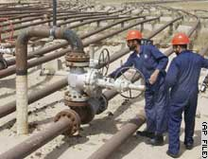
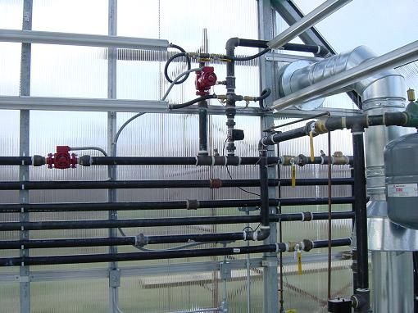
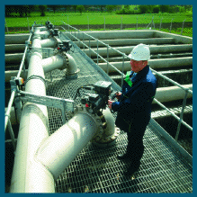
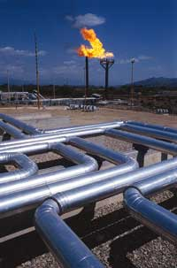

Graph Theory and its Applications
Network Flow
In a network of telephone lines, highways, railroads, pipelines of oil (or gas or water, one wishes to know the maximum rate of flow that is possible from one station to another in the network.
This n/w is represented by a weighted connected graph in which the vertices are the stations and the edges are lines through which the given commodity (oil, gas, water, number of messages, number of cars, etc.) flows.

Slide 4
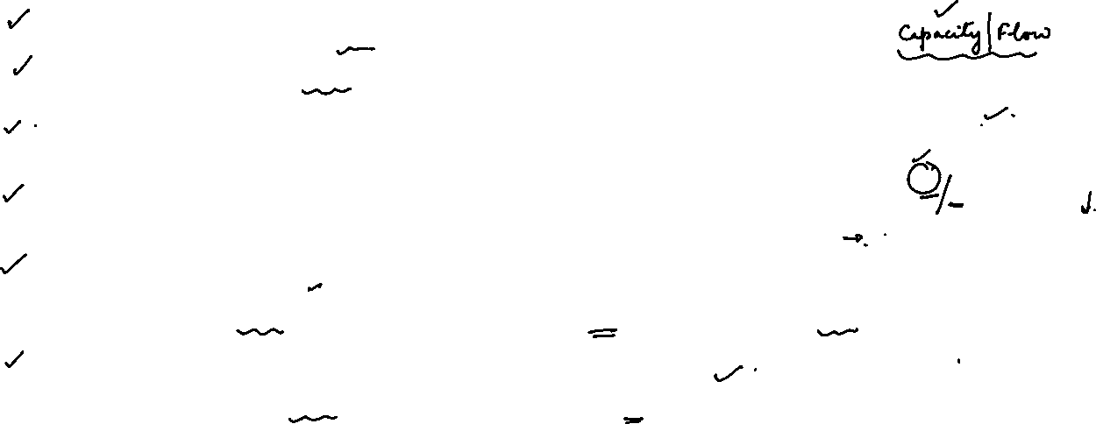
Graph Theory and its Applications
Network Flow
A transportation network is a connected, weighted, directed graph
Source: a vertex with no incoming edges
Sink: a vertex with no outgoing edges
Intermediate vertices: Vertices with both incoming and outgoing edges
Capacity: Each edge is associated with a capacity that represent that maximum rate of flow through that edge
Capacity Condition
Flow at any edge F_{ij} cannot exceed the capacity of the edge Cij
Conservation Condition
Net (Resultant) flow at any intermediate vertex is zero
u
20
10
s
30
t
10
20
v

Slide 5
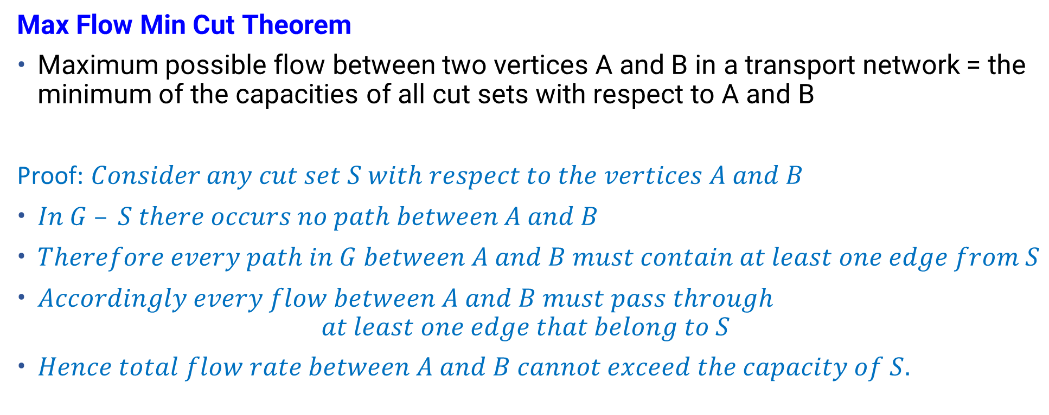
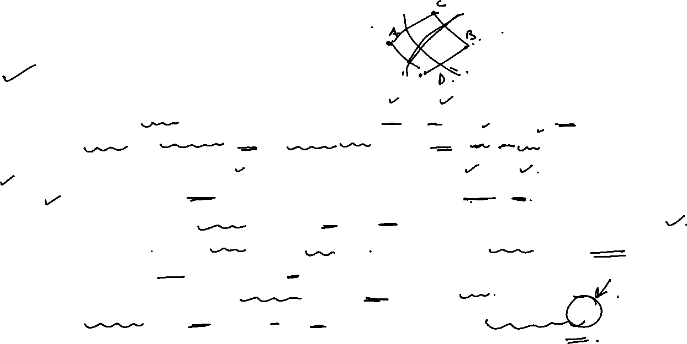
Graph Theory and its Applications
Network Flow
Max Flow Min Cut Theorem
Maximum possible flow between two vertices A and B in a transport network = the minimum of the capacities of all cut sets with respect to A and B
Proof: $Consider any cut set S with respect to the vertices A and B$
$In G – S there occurs no path between A and B$
$Therefore every path in G between A and B must contain at least one edge from S$
$Accordingly every flow between A and B must pass through$
$$at least one edge that belong to S$$
$Hence total flow rate between A and B cannot exceed the capacity of S.$

Slide 6
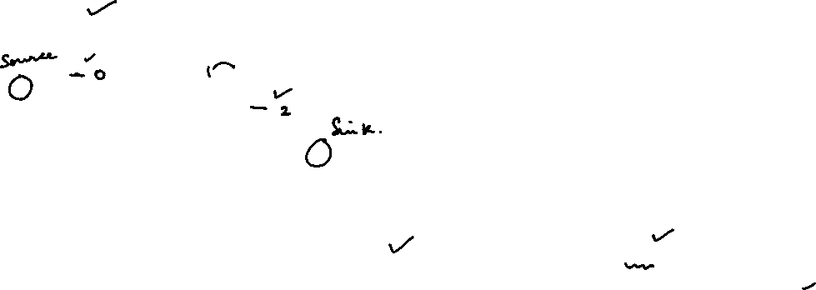
Graph Theory and its Applications
Network Flow
Calculate the Flow in the network
Let A be the source and Z is the sink
Consider all paths between A and Z
Consider the path:
A- B- Z - Flow is 6
6
B
A
8
3
5
Z
2
7
D
4
C
6 0
B
A
8 2
3
5
Z
2
7
D
4
C

Slide 7
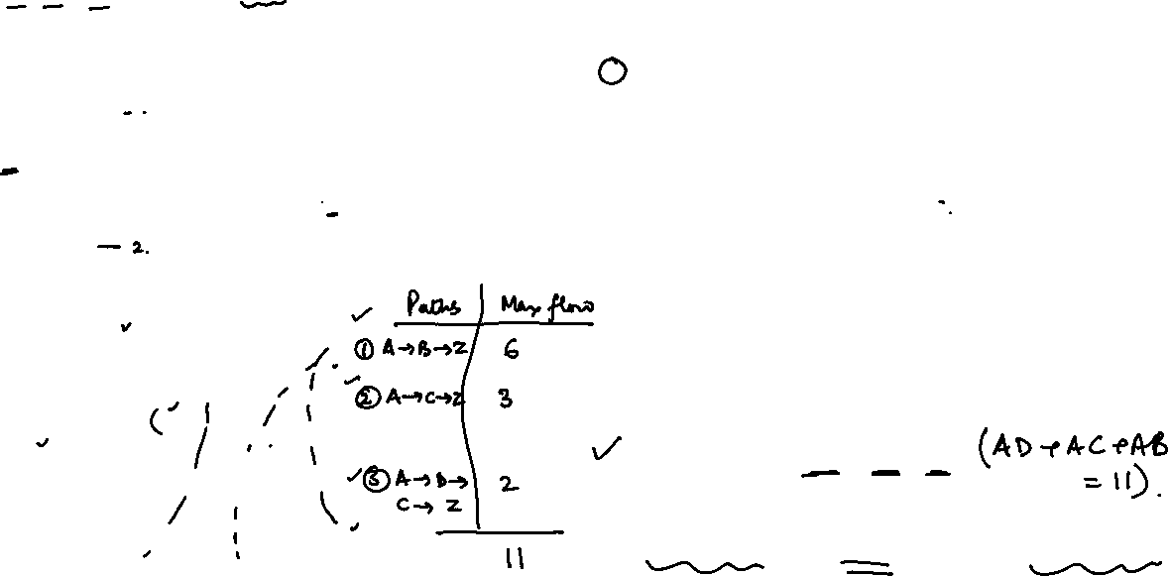
Consider the path:
A- C- Z - Flow is 3
A-D-C-Z - Flow is 2
6 0
B
6 0
B
A
A
8 2
8 2
3 0
3 0
5
Z
Z
2
2 0
5
7 4
7 4 2
D
4
C
D
4 2
C
All paths are covered
Max flow is - 6+3+2 =11
Min Cut is - AD, AC, AB
Max Flow Corresponds to Min Cut
6
B
A
8
3
5
Z
2
7
D
4
C

Slide 8
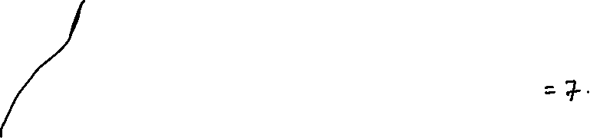
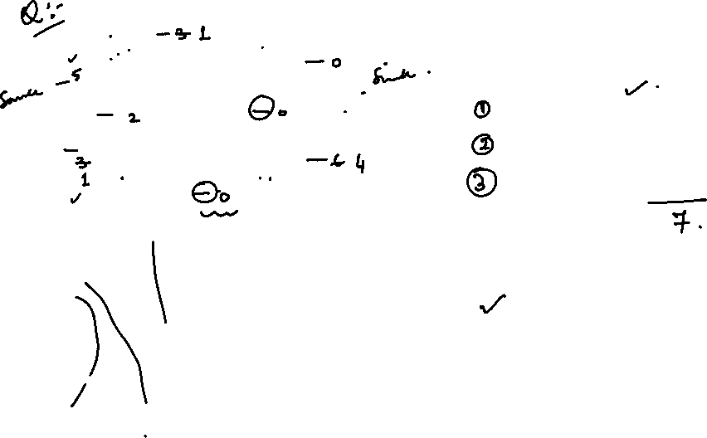
Graph Theory and its Applications
Network Flow
B
5
C
Source A, Sink Z
A-B-C-Z - 2
A-E-D-Z - 3
A-E-B-C-D-Z - 2
Max flow is - 2+3+2=7
Min Cut is - CZ + CD +ED =2+2+3
2
7
2
Z
4
A
6
9
E
3
D
3-2
B
5-2
C
2-2=0
7-2
2-2
Z=2+3+2
4 -2
A
6-3
9-3
3-2=1
6-2
3 -3 =0
E
D

Slide 9
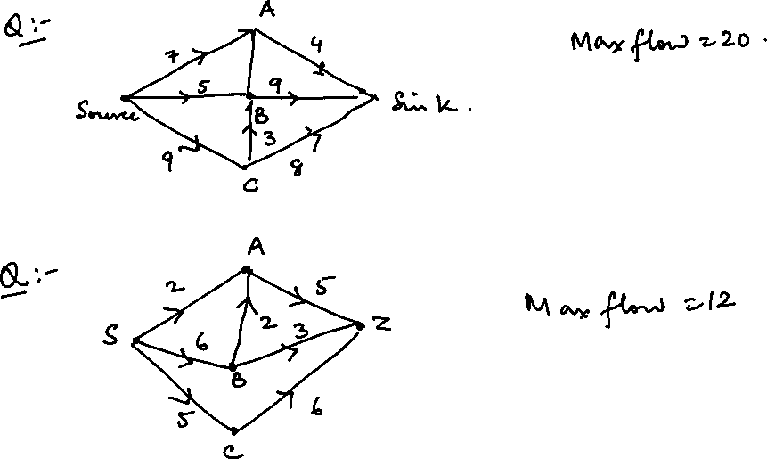

Slide 12
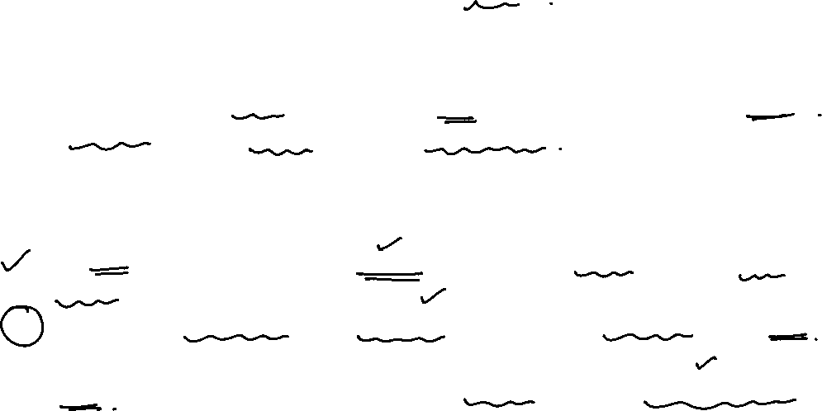
Graph Theory and its Applications
Graph Applications - Ford Fulkerson’s Algorithm for max flow
Intuition:
As long as there is a path from the source to the sink that can take some flow the entire way, we send it. This path is called an augmenting path. We keep doing this until there are no more augmenting paths.
While constructing an augmented path, the algorithm considers
Non-Empty ( or non-full) Forward edges (Push forward as long as full capacity is not reached)
Non-Zero backward edges (Push reverse if there’s some available capacity)
Ford Fulkerson’s Algorithm respects both capacity and conservation constraints

Slide 13
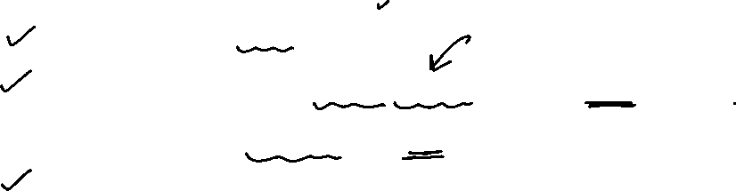
Graph Theory and its Applications
Graph Applications - Ford Fulkerson’s Algorithm for max flow
Ford-Fulkerson Algorithm
Start with initial flow as 0.
While there is an augmenting path from source to sink.
Add this path-flow to flow.
Return flow.

Slide 14
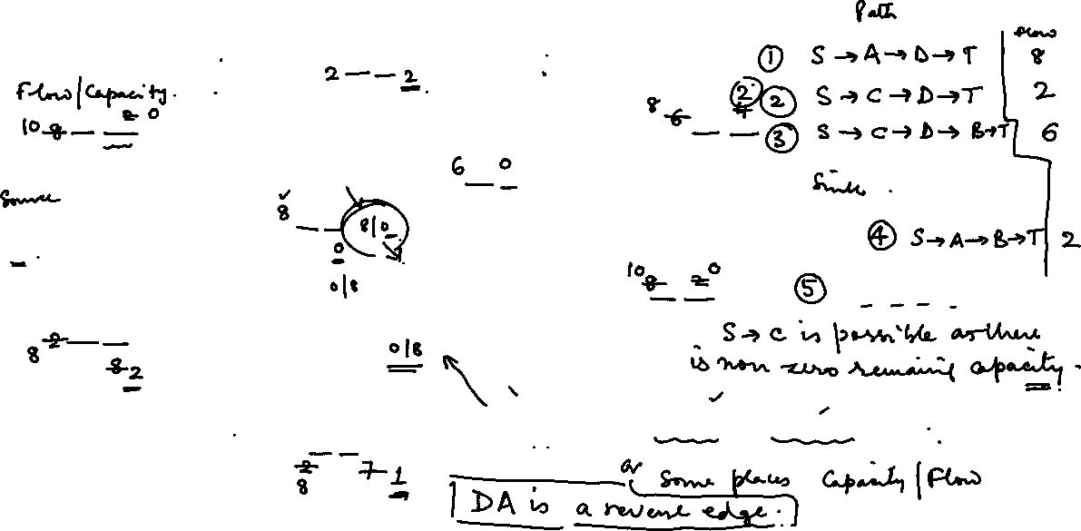
Graph Theory and its Applications
Graph Applications - Ford Fulkerson’s Algorithm for max flow
Example
A
B
0/4
0/10
0/10
0/6
s
0/8
T
0/2
0/10
0/10
C
D
Flow/Remaining Capacity
0/9

Slide 15
Graph Theory and its Applications
Graph Applications - Ford Fulkerson’s Algorithm for max flow
A
B
0/4
8 0/10 2
0/10
0/6
s
8 0/8 0
T
0/2
8 0/10 2
0/10
PATH | FLOW
S-A-D-T | 8
C
D
0/9

Slide 16
Graph Theory and its Applications
Graph Applications - Ford Fulkerson’s Algorithm for max flow
A
B
0/4
0/10
8 0/10 2
0/6
s
T
8 0/8 0
0/2
2 0/10 8
10 8 0/10 2 0
PATH | FLOW
S-A-D-T | 8
S-C-D-T | 2
C
D
2 0/9 7

Slide 17
Graph Theory and its Applications
Graph Applications - Ford Fulkerson’s Algorithm for max flow
A
B
0/4
6 0/10 4
8 0/10 2
6 0 /6 0
s
8 0/8 0
T
0/2
10 8 0/10 2 0
8 2 0/10 8 2
PATH | FLOW
S-A-D-T | 8
S-C-D-T | 2
S-C-D-B-T | 6
C
D
8 2 0/9 7 1

Slide 18
Graph Theory and its Applications
Graph Applications - Ford Fulkerson’s Algorithm for max flow
A
B
2 0/4 2
8 6 0/10 4 2
10 8 0/10 2 0
6 0 /6 0
s
T
8 0/8 0
PATH | FLOW
S-A-D-T | 8
S-C-D-T | 2
S-C-D-B-T | 6
S-A-B-T | 2
0/2
10 8 0/10 2 0
8 2 0/10 8 2
C
D
8 2 0/9 7 1

Slide 19
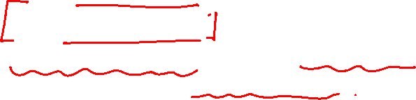
Graph Theory and its Applications
Graph Applications - Ford Fulkerson’s Algorithm for max flow
A
B
2 0/4 2
PATH | FLOW
S-A-D-T | 8
S-C-D-T | 2
S-C-D-B-T | 6
S-A-B-T | 2
8 6 0/10 4 2
10 8 0/10 2 0
6 0 /6 0
s
T
0/2
8 0/8 0
8 2 0/10 8 2
10 8 0/10 2 0
C
D
S-C -D-T Not Possible, No Capacity
S-C -D-B Not Possible, No Capacity
S-C-D-A —-?
D-A is reverse edge
D-A has some flow, Can we make the flow go in opp direction and reach A?
8 2 0/9 7 1
Are there anymore flows?
Starting from S,
S-A Not possible (No capacity)
S-C - Possible, S-C-D Possible

Slide 20
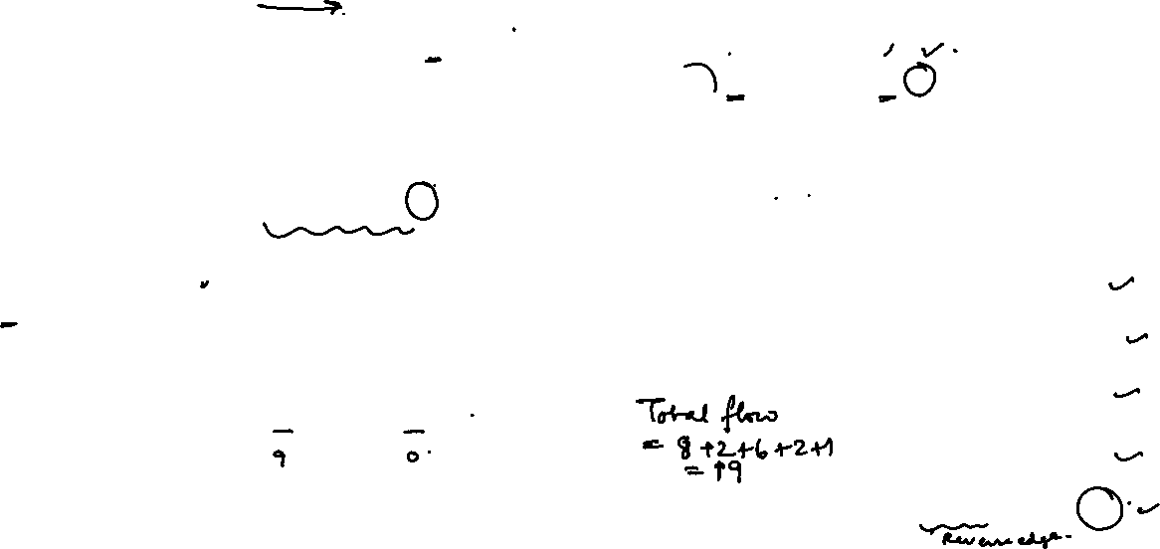
Graph Theory and its Applications
Graph Applications - Ford Fulkerson’s Algorithm for max flow
A
B
3 2 0/4 2 1
9 8 6 0/10 4 2 1
10 8 0/10 2 0
6 0 /6 0
s
T
7 8 0/8 0 1
0/2
PATH | FLOW
S-A-D-T | 8
S-C-D-T | 2
S-C-D-B-T | 6
S-A-B-T | 2
S-C-D-A-B-T | 1
10 8 0/10 2 0
9 8 2 0/10 8 2 1
C
D
8 2 0/9 7 1
Reverse edge D-A is considered here as the flow is nonzero

Slide 21
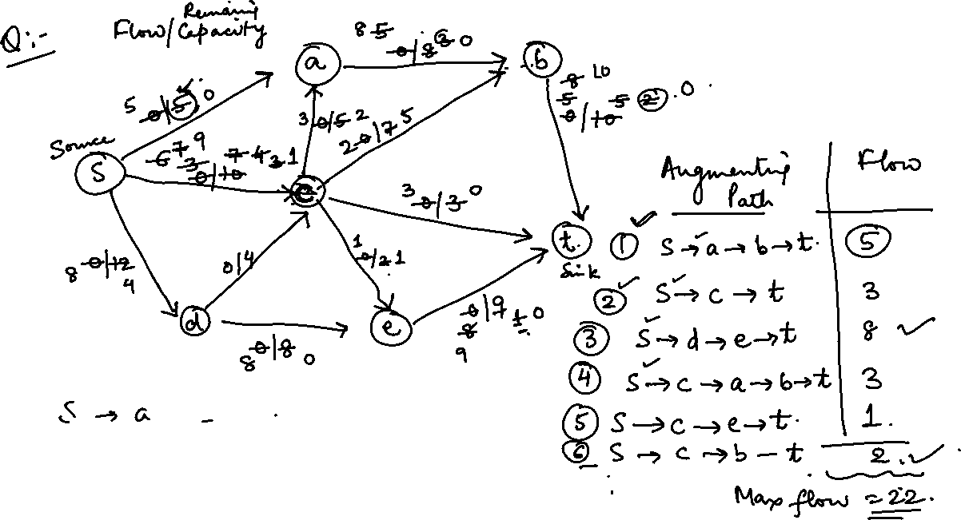

Slide 22
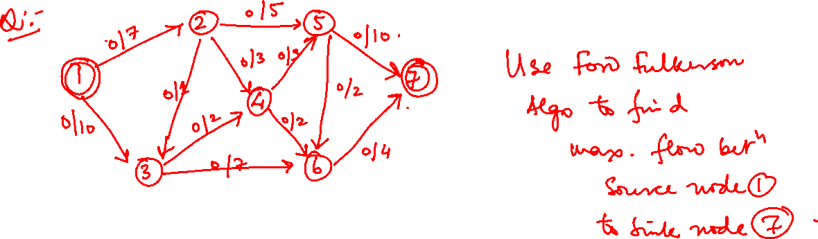

Slide 27
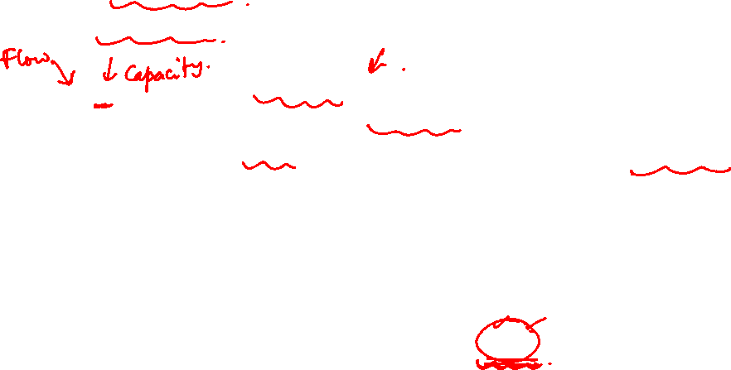
Graph Theory and its Applications
Non Empty Forward edges/ Non Zero backward edge
Meaning of:
Non Empty Forward edges (Push forward as long as full capacity is not reached)
Non Zero backward edges (Push reverse if there’s some available capacity)
0/8
Here, Capacity is 8, and there’s no flow (empty).
Flow can be pushed forward.
But, cannot push backward because there’s no flow
Here, Flow is 8 and Capacity is 0. So, Cannot push forward, but can be pushed backward
8/0
4/4
What happens in this case?

Slide 28
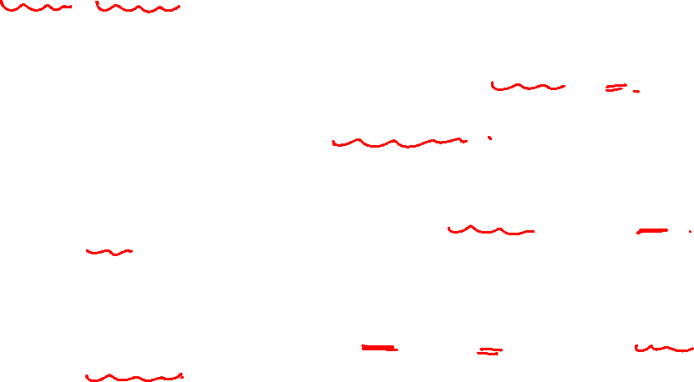
Graph Theory and its Applications
Push - Relabel Algorithm
Push relabel algorithm is also known as Preflow Push algorithm.
It is used for computing maximum flows in a flow network.
Maximum flow in a network graph
In a network graph where every edge has a given capacity, maximum flow is defined as the maximum amount of flow that can move from source to sink. Maximum flow is calculated using two constraints,
For every vertex (except source and sink), incoming flow is equal to outgoing flow.
Flow of an edge shouldn't exceed its capacity

Slide 29
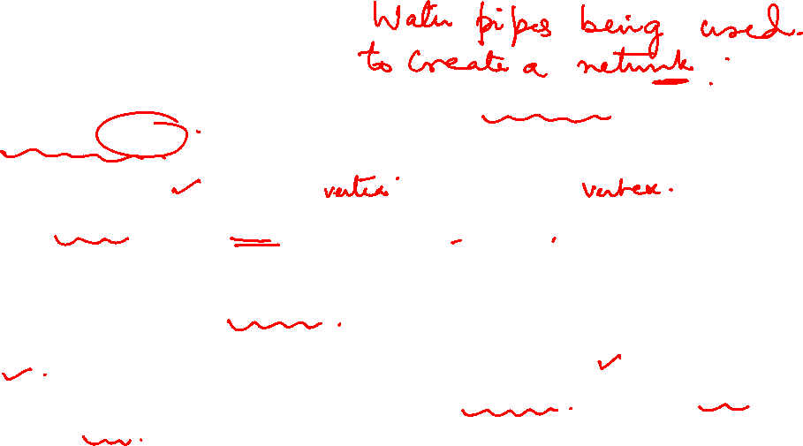
Graph Theory and its Applications
Push - Relabel Algorithm
Conceptual framework:
The idea behind the algorithm is that the edges act as pipes and vertices act as joints.
Water flows from a high height joint to a low height joint.
Every node is assigned a height variable.
The source is considered to be at the highest height |V| and sink is at the lowest height 0.

Slide 30
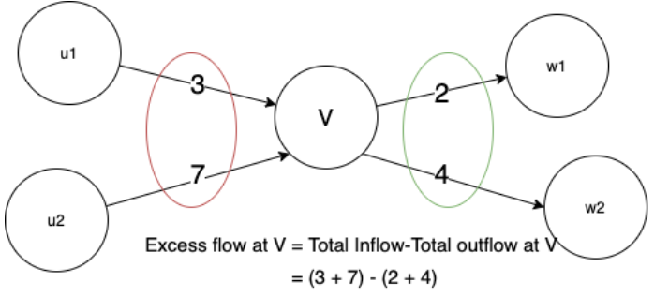
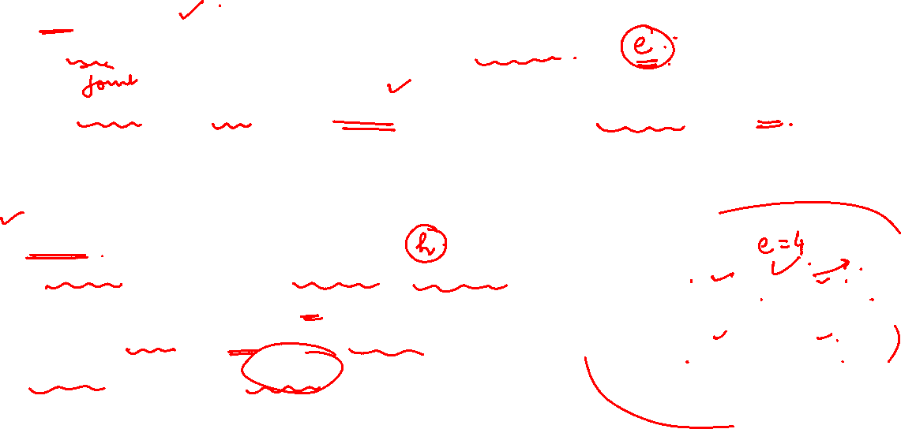
Graph Theory and its Applications
Graph Applications - Push - Relabel Algorithm
Push Operation:
Every vertex is also assigned another variable excess flow.
Excess flow at a vertex V= Total flow received by V - Total flow going out of V.
When a vertex has an excess flow, it pushes it to a lower height vertex. The amount of flow pushed is equal to the minimum (excess flow of vertex, capacity of connecting edge.)
Relabel operation
In a relabel operation, the vertex height is increased.
If the height of a vertex is low and the water is
overflowing into that vertex, i.e the water gets
locally trapped, then it's relabled.

Slide 31

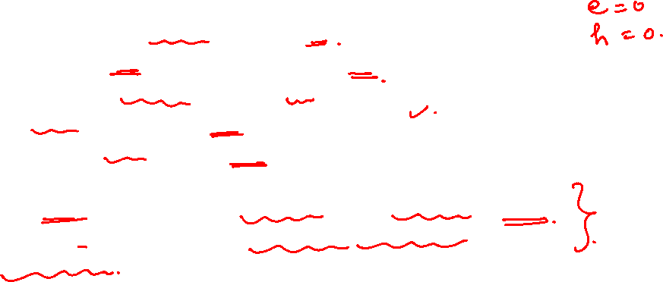
Graph Theory and its Applications
Graph Applications - Push - Relabel Algorithm = Psuedocode
Initialise height of all the vertices as 0
Initialise excess flow of all the vertices as 0
Initialise Height of source = |V| = n
For all neighbouring vertices of source node:
Compute Flow and excess flow (initially, this is equal to the capacity of the connecting source-neighbour edge)
While there is a vertex with excess flow: Perform push –relabel
Continue till all the vertices should have 0 excess flow.
Return maximum flow

Slide 32
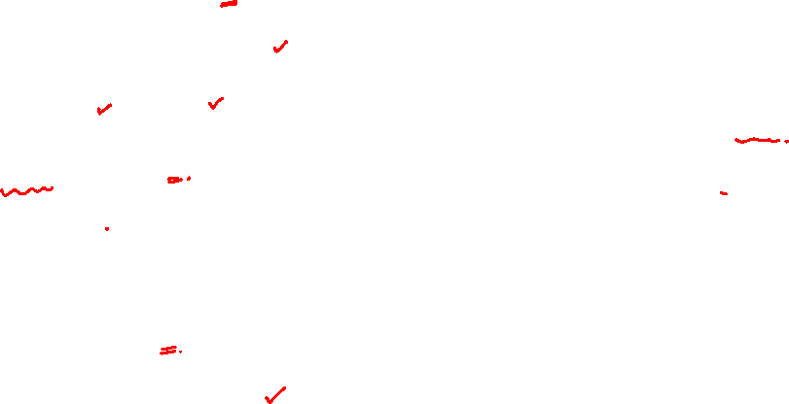
Graph Theory and its Applications
Graph Applications - Push - Relabel Algorithm
h=0
e=0
h=0
e=0
A
15/0
B
Capacity/Flow
3/0
h=0
h=6
10/0
T
S
5/0
8/0
17/0
12/0
C
D
h=0
e=0
h=0
e=0
6/0

Slide 33
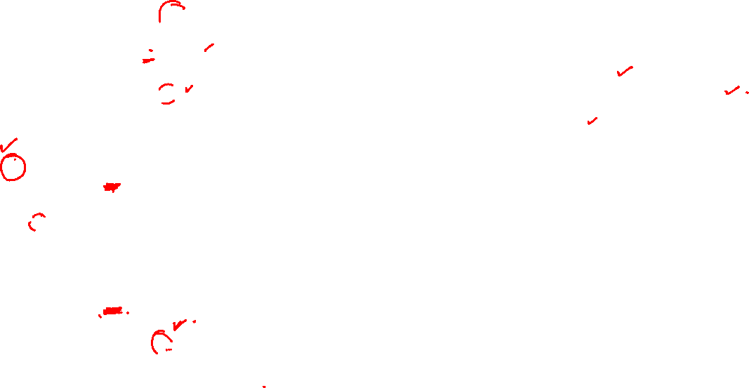
Graph Theory and its Applications
Graph Applications - Push - Relabel Algorithm
h=0
e=10
h=0
e=0
h(s) = |V|=6
A and C are active
e(A) = 10
e(C)=12
C has Max Excess Flow
Choose C for Push-Relabel
A
15/0
B
3/0
h=0
Capacity/Flow
h=6
10/10
T
S
5/0
8/0
17/0
12/12
C
D
h=0
e=0
h=0
e=12
6/0

Slide 34
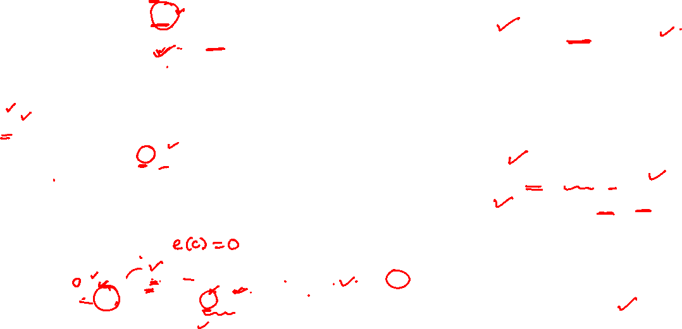
Graph Theory and its Applications
Graph Applications - Push - Relabel Algorithm
Choosen vertex C
h(c)= h(c) +1 =1
Push 6 from C to D
Push 5 from C to A
e(c) = 1
Push Backward
h(c)= h(s) +1 =7
Push back 1 to S
e(C) = 0
A and D are active
Choose A
(inflow(A)> inflow(D))
h=0
e=15
h=0
e=0
Capacity/Flow
15/0
A
B
3/0
h=0
10/10
h=6
T
S
5/5
8/0
17/0
12/11
C
D
h=0
e=6
h=1 7
e=12 1 0
6/6

Slide 35
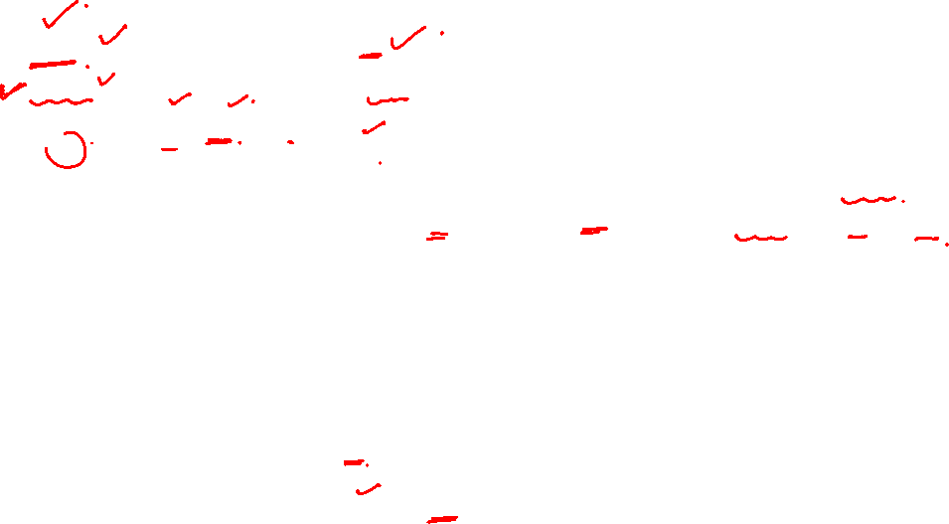
Graph Theory and its Applications
Graph Applications - Push - Relabel Algorithm
h=1
e=0
h=0
e=15
A
15/15
B
Capacity/Flow
Choosen vertex A
h(A)= h(A) +1 =1
Push 15 from A to B
e(A) = 0
B and D is active
Choose B
3/0
h=0
h=6
10/10
T
S
5/5
8/0
17/0
12/11
C
D
h=0
e=6
h=7
e=0
6/6

Slide 36
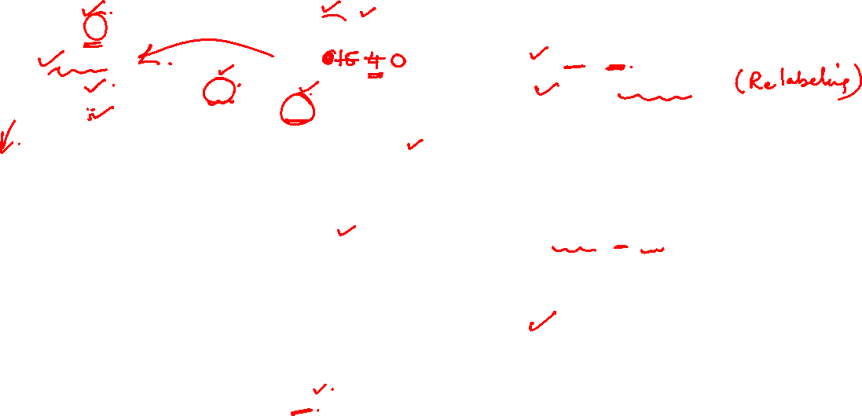
Graph Theory and its Applications
Graph Applications - Push - Relabel Algorithm
h=1
e=4
h= 1 2
e=0
Choose vertex B
e(b)=15
h(B)= h(B) +1 =1
Push 3 from B to T
Push 8 from B to D
Re-label B to push back excess water to A
h(B)= 1 +1 =2
Push back 4 from B to A
e(A) = 4
e(b)=0
A and D are active (S&T do not become active)
Choose A (You may choose D also since flow is higher)
A
15/11
B
Capacity/Flow
h=0
e=3
3/3
h=6
10/10
T
S
5/5
8/8
17/0
12/11
C
D
h=0
e=14
h=7
e=0
6/6

Slide 37
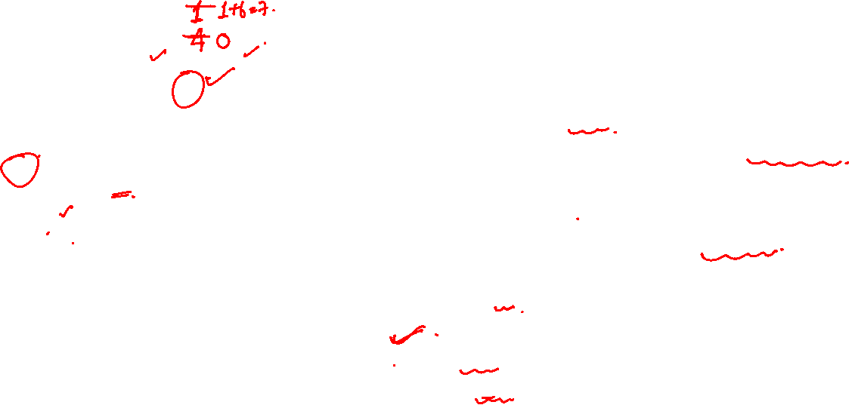
Graph Theory and its Applications
Graph Applications - Push - Relabel Algorithm
h=7
e=0
h=2
e=0
A
15/11
B
Chosen Vertex A
e(A) =4
h(A)= h(S)+1=7
Push 4 to S
e(s) = 4
e(A)=0
Only active node is d
Capacity/Flow
h=0
e=3
3/3
h=6
10/10
T
S
5/5
8/8
17/0
12/11
C
D
h=1
e=14
h=7
e=0
6/6

Slide 38

Graph Theory and its Applications
Graph Applications - Push - Relabel Algorithm
h=7
e=0
h=2
e=0
A
15/11
B
Capacity/Flow
h=0
e=17
Chosen Node D e(D)=14
h(D)= h(D) +1 =1
Push 14 to T
e(t) =14+3
e(D)=0
3/3
h=6
10/6
T
S
5/5
8/8
17/14
12/11
C
D
h=1
e=0
h=7
e=0
6/6

Slide 39
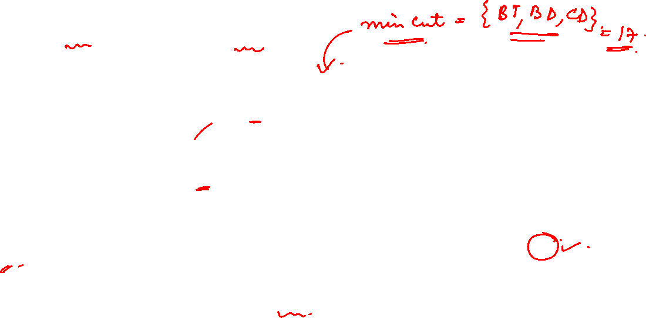
Graph Theory and its Applications
Graph Applications - Push - Relabel Algorithm
h=7
e=0
h=2
e=0
A
15/0
B
Capacity/Flow
Node | Hieght | Excess Flow
S | 6 | 0
A | 7 | 0
B | 3 | 0
C | 7 | 0
D | 1 | 0
T | 0 | 17
h=0
e=17
h=6
e=0
3/3
10/6
T
S
5/0
8/8
17/14
12/11
C
D
h=1
e=0
h=7
e=0
6/6

Slide 40
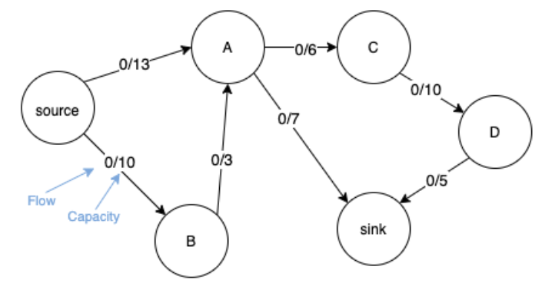

Graph Theory and its Applications
Graph Applications - Push - Relabel Algorithm
Use Push-Relabel to find max flow between Source and Sink.
Flow/Capacity

Slide 41
THANK YOU
Arti Arya
Department of Computer Science &Engineering
artiarya@pes.edu

